Slide 1
GESTURE CONTROL MOUSE USING PYTHON
PRESENTED BY :
MEDAMALLA SANJAY
210304124063
B.TECH CSE
ARTIFICIAL INTELLIGENCE
UNDER THE GUIDANCE OF :
Ms.KUSHI MANOHAR
ASSISTANT PROFESSOR,
DEPARTMENT OF COMPUTER
SCIENCE AND ENGINEERING

Slide 2
CONTENTS
Introduction
Existing System and Drawbacks
Proposed System and Advantages
Hardware and Software Specifications
Design(Block Diagram/UML/Modules)
Implementation(Technology used)
Testing
Results
Conclusion and Future work
References/Bibliography

Slide 3
ABSTRACT
The mouse is one of the marvelous inventions of Human Computer Interaction (HCI) technology.
Currently, wireless mouse still uses devices and is not free of devices completely, since it is using a battery for power and a dongle to connect it to the PC.
In the proposed virtual mouse system, this limitation can be overcome by employing a simple webcam for capturing of hand gestures using computer vision.
The Virtual Mouse provides an infrastructure between the user and the system.
This presents a method for controlling the cursor's position without the need of any electronic equipment. While actions such as clicking and dragging things will be carried out using various hand gestures.
The suggested system will make use of OpenCV , Media pipe and Python as well as other Packages.

Slide 4
INTRODUCTION
Virtual Mouse using Hand Gesture goes to be a commendable change within the world of technology, in this system we are employing our fingers to manage the mouse.
The initial step includes a camera that can be used for providing the input to the system.
The process is divided into 4 steps: Frame-capturing, Image-processing, Region, and Frame extraction, Frame-matching.
Python programming language is used for developing the virtual mouse system and also,OpenCV stands for open-source computer vision, it is a library used for image processing.This model makes use of the MediaPipe package for Packing of the hands and for tracking the tip of the hands.
PyAutoGUI packages were used for moving around the window screen of the computer for performing functions.

Slide 5
EXISTING SYSTEM AND DRAWBACKS
The Mechanical mouse known as the Packball mouse that is commonly used in the 1990s, the ball within the mouse are supported by two rotating rollers in order to detect the movement made by the ball itself.
Optical and Laser mouse that commonly used in these days, the motions of optical mouse rely on the Light Emitting Diodes (LEDs) to detect movements relative to the underlying surface.
Wireless mouse are connected to the computer with the help of mouse receiver.
Physical mouse is subjected to mechanical wear and tear and also, requires special hardware and surface to operate.
It is not easily adaptable to different environments and its performance varies depending on the environment.

Slide 6
PROPOSED SYSTEM AND ADVANTAGES
This project promotes an approach for the Human-Computer Interaction (HCI) where cursor motion can be managed using real-time digital camera.
It enables user to simulate Mouse operations such as Click, Double Click, Dragging, Volume using Hand Gestures without any Hardware.
Provides greater flexibility, easier to adapt and less prone to physical damage.
Convenient and Cost effective.
People who are physically challenged and unable to use their hands on physical mouse so we try to give them an easy method to go their task easily and effortlessly.

Slide 7
HARDWARE AND SOFTWARE REQUIREMENTS
HARDWARE REQUIREMENTS
Processor: i3 or above
RAM: 8 GB or more
Webcam: 720p HD
Resolution: 1920 x 1050
SOFTWARE REQUIREMENTS
Operating System: Windows XP, 7, or higher
IDLE: PyCharm
Programming Language: Python and required packages

Slide 8
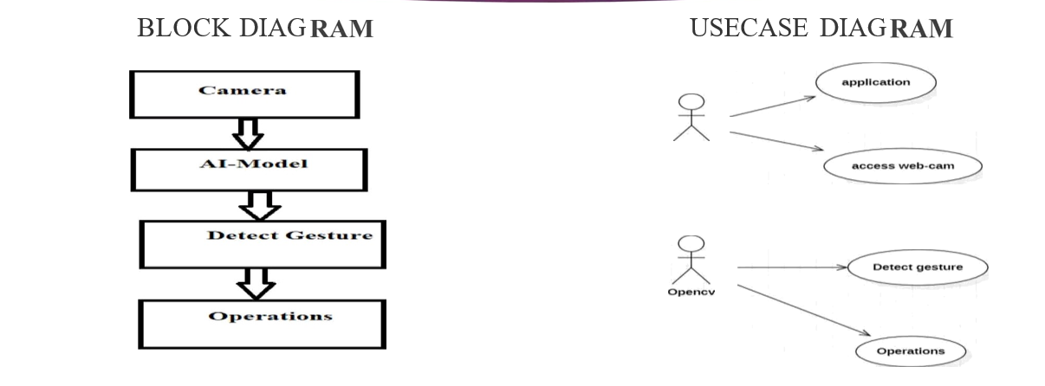
DESIGN

Slide 9
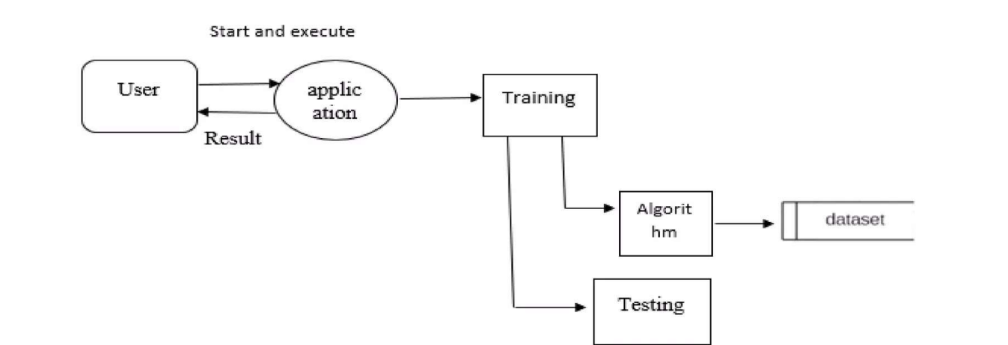
DATA FLOW DIAGRAM

Slide 10
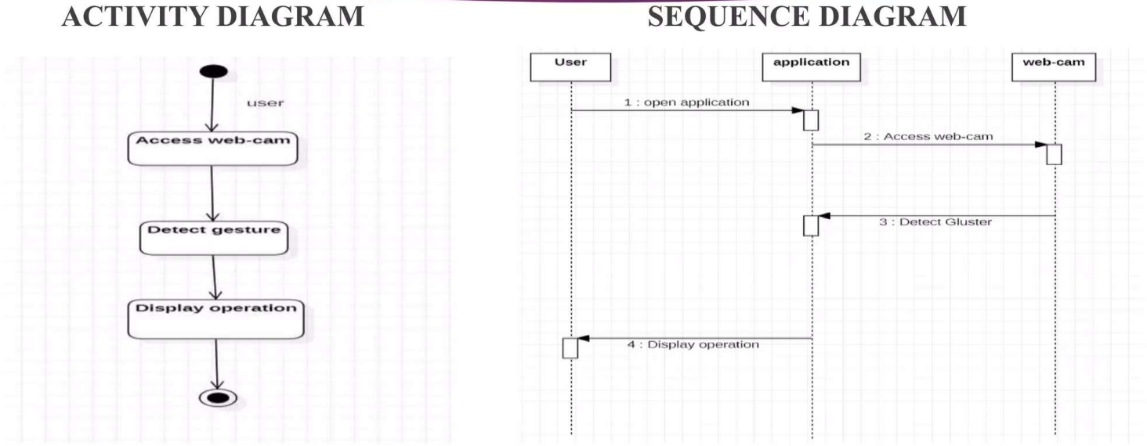
DATA FLOW DIAGRAM

Slide 11
MODULES
OpenCV
Pandas
Tkinter
Numpy

Slide 12
IMPLEMENTATION
Camera used in proposed AI Virtual Mouse System:
The proposed Al virtual mouse system is based on the frames that have been captured by the webcam in a laptop or PC. By using the Python computer vision library OpenCV.
Capturing the Video and Processing:
The video frames are processed from BGR to RGB colour space to find the hands in the video frame by frame as shown in the following code:
def findHands(self, img , draw = True):
imgRGB = cv2.cvtColor(img , cv2.COLOR BGR2RGB)
self.results = self.hands.process(imgRGB)

Slide 13
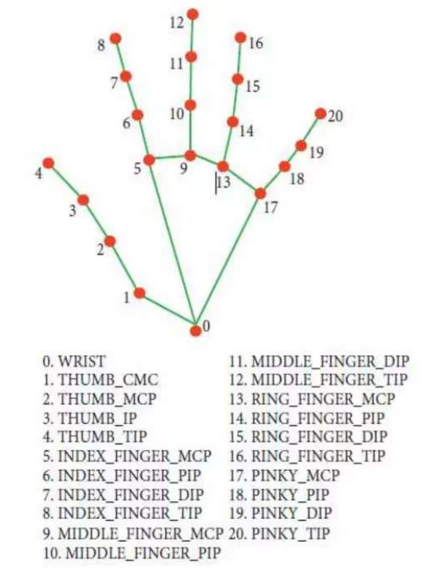
IMPLEMENTATION
Rectangular region for moving through the window:
The AI virtual mouse system makes use of the transformational algorithm, and it converts the coordinates of fingertip from the webcam screen to the computer window full screen for controlling the mouse
Detecting Which Finger Is Up and Performing the Particular Function.
iMouse Functions Depending on the Hand Gestures and Hand Tip Detection Using Computer Vision For the Mouse Cursor Moving around the Computer Window

Slide 14
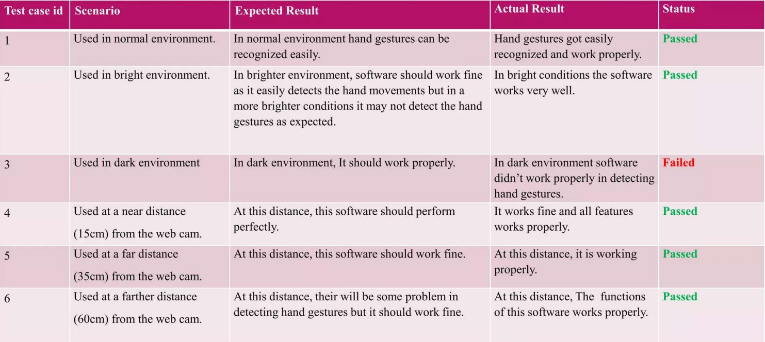
TESTING

Slide 15
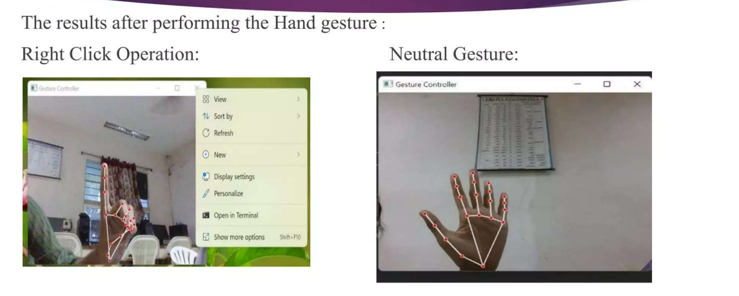
RESULTS

Slide 16
CONCLUSION AND FUTURESCOPE
The accuracy and efficiency play an important role in making the program as useful as an actual
physical mouse, a few techniques had to be implemented.
After implanting such type of application, there is a big replacement of the physical mouse, i.e.,
there is no need for any physical mouse. Each & every movement of the physical mouse is done
with this Virtual Mouse.
There are several features and improvements needed in order for the program.
Smart Movement: Due to the current recognition process being limited within a 25cm radius,
adaptive zoom in/out functions are required to improve the covered distance, where it can
automatically adjust the focus rate based on the distance between the users and the webcam.
Better Accuracy & Performance: The response time heavily relies on the hardware of the
machine, including the processing speed of the processor, the size of the available RAM, and
the available features of the webcam.

Slide 17
THANK YOU

